Slide 1
Week 7
QA Automation Course

Slide 2
Homework review

Slide 3
What we’ll do today
Selenium SetUp and TearDown Demo
Run tests in different browsers

Slide 4
Demo
Selenium SetUp and TearDown

Slide 5
Homework
Create SetUp and TearDown for your own TestFixture

Slide 6
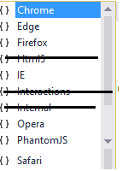
Run tests in FireFox, IE, etc
Add the respective Driver to the project (using NuGet packages, or by downloading it)
Add the respective using clause to your class file:
using OpenQA.Selenium.Firefox;
Create new driver object of the respective type:
IWebDriver driver = new FirefoxDriver();

Slide 7
Run tests in FireFox, IE, etc
DEMO: add test for firefox

Slide 8
Homework
Create SetUp and TearDown for your own TestFixture
Choose one of your tests, and make it run on Gchrome, FireFox, IE

Slide 9
Q & A

Slide 10
Sources:

